Slide 1
Nordea CMDB
Rene Popp-Madsen, Configuration Management Technical Lead

Slide 2
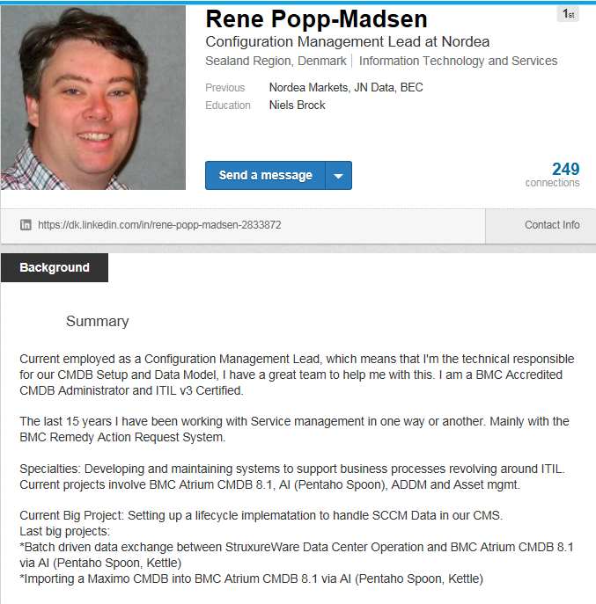
Who am I ?
Notes:
Bla bla bla Linkedin reach out !!!!

Slide 3
The journey so far…
2011
2012
2013
2014
2015
2016
DCO, Pentaho Batch
146000
1.7 mil.
NP in. ADDM
125000
1 mil.
SCCM
27000
49000
Progo
17000
32000
ITSM
15000
26000
Remedy
v2
8000
12000
Milestone
Computer
system
All Obejcts
Notes:
2011: No ”CMDB” Asset list – Relations, Remedy v2 new instance
2012: implementing ITSM suite Incident-Change-Asset as IO Servicemanagement suite, introducing a common tool set that shares data
2013: Procesess and thier governance are gathered in a single team called progo (Process Governance) lays foundation for tool usage
2014: Instead of manual spreadsheets, now we get data directly from tools like SCCM, but still in csv files or spreadsheets
2015: Insourcing Nordic processor, Implementing ADDM
2016:New sources like DCO, aligning Batch loads, focusing on data quality and overall mature our work and process setup.

Slide 4
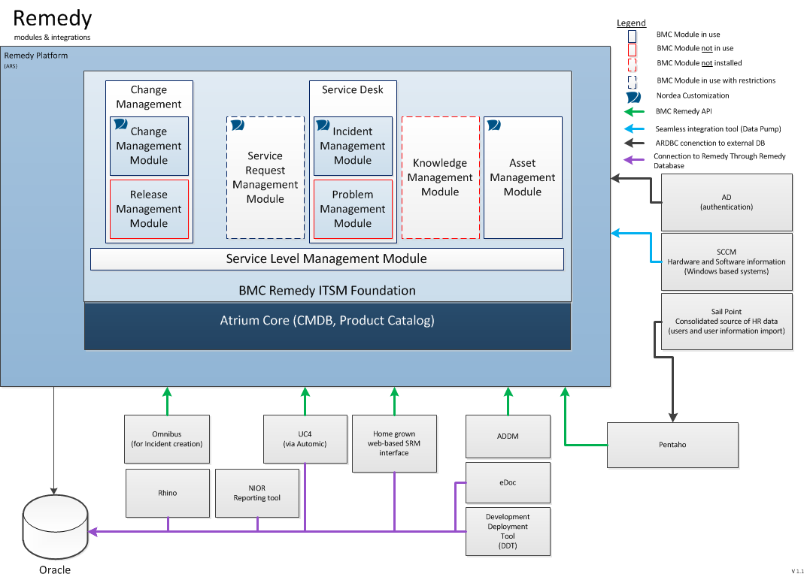
The Setup
Notes:
How do we connect

Slide 5
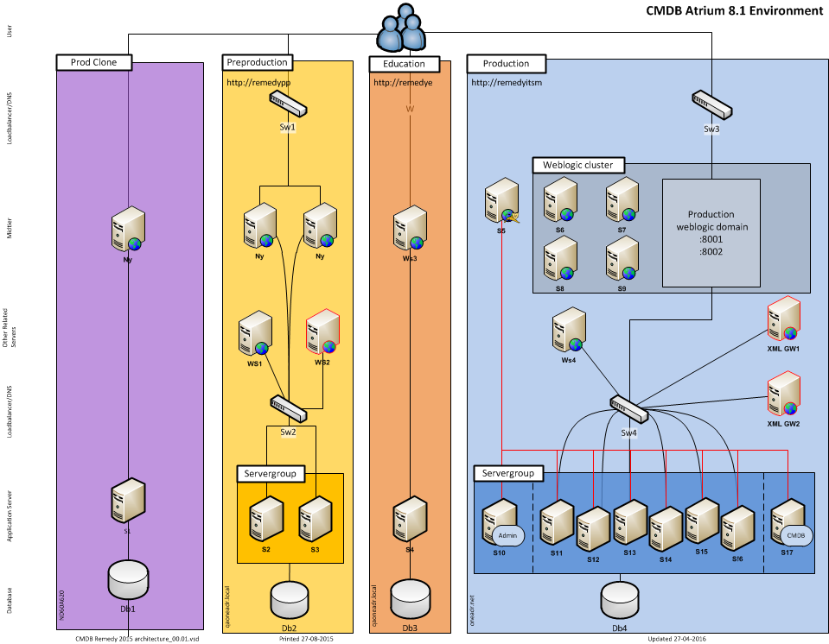

Slide 6
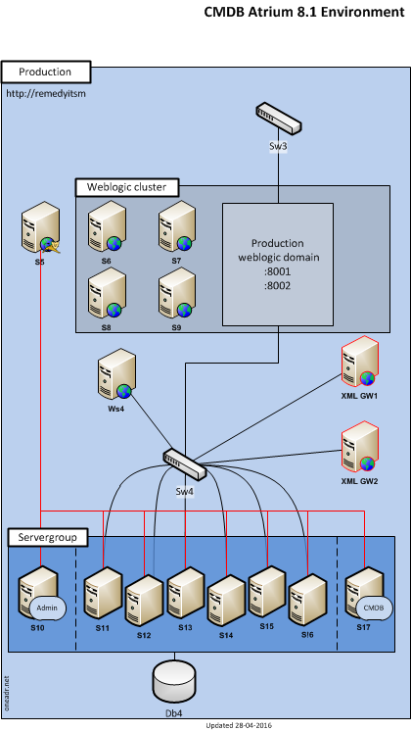
The Hardware
Midtier: 8.1 patch 2
Weblogic
AR server: 8.1
Win OS
DB: Oracle 11.2.03

Slide 7
The Engine Room
Extract
Transform
Load
Cleanse and Reconcile
Consume
Atrium CMDB
ADDM
N
O
R
M
A
L
I
Z
A
T
I
O
N
Product
Catalog
ADDM
Dataset
ITSM
AdHoc
R
E
C
O
N
C
I
L
I
A
T
I
O
N
CIs
CIs
SIM
NIOR
MS SCCM
Pentaho
SCCM
Dataset
ITBM
.
.
.
.
.
.
.
.
.
.
.
.
.
Production
Dataset
CIs
CIs
Dashboards
RIO
.
.
.
.
Any Data
Source
IMPORT
Dataset
Error
Dataset
CIs
CIs
Staging
Dataset
BPPM
Notes:
Engine Room

