Slide 1

CMDB
From development phase to the day2day business
Vi behöver både bra samarbete och bra IT-lösningar

Slide 2
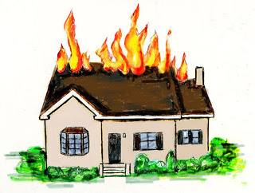

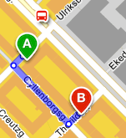
Process dependencies
Incident Process
Get the service up and running asap or create a workaround.
Problem Process
Root cause of an incident.
Key personnel
Charging
Change Process
Necessary changes / improvements in the IT environment.
Capacity
Configuration Management
Information about hosts/applications and their relationships.

Slide 3
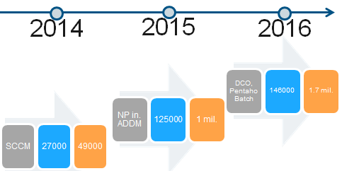
The journey
Decentralized IT ➔ Centralized IT
Sub suppliers and small in house suppliers
Quick and dirty
Poor data quality
No trust of the data
A lot of small CMDBs

Slide 4
A new way of handling data
Expected benefits
Higher data quality
Gain knowledge through relationships
Act proactively
Ability to quickly recover from Incidents
Generate reports:
  Troubleshooting
  Charging
Create an overview/map on areas of responsibilities.

Slide 5

Challenges
Get stakeholders and key personnel on board
  Who should be responsible for addressing when data is incorrect in the CMDB?
Secure data consistency
  Audits: How often and with whom?
Secure that the CMDB follows the business needs
  Market the value from using a CMDB and Configuration Mgmt
  Measure the value

