Slide 1
Traceability in a Networked Society
How and what enables traceability when moving towards a Networked Society

Slide 2
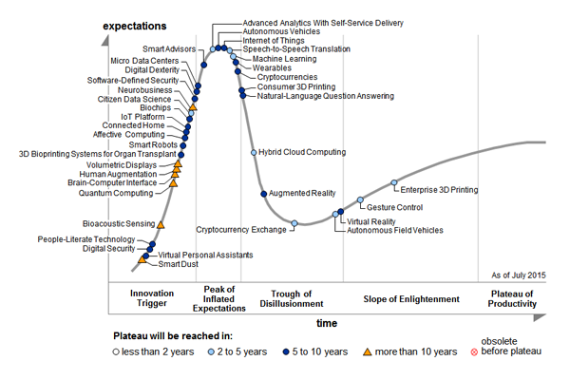
Emerging Technologies

Slide 3

Connection Identification
IMEI
IMEI
IP
PORT
MAC
IP
Sensor ID
IP
IP
MAC
MAC
MAC
IP
PORT
MAC
IP
IMEI/
MAC
MAC
MAC
MAC
URL
Tag ID
PORT
Sensor ID
URL
ID
PORT

Slide 4

System architecture
Solution
Product
Component
Material

Slide 5

Need to delivery
Need
Offer
Order
Delivery
Invoice

Slide 6
Unique Identification
Communication
  IP address
  MAC address
  IMEI
  Tag ID
Position
  Location code
  Address
Distribution
  Shipment ID
  Transport ID
  Package ID
Individual
  Vehicle ID
  Serial number
  TIM UUID
  IMSI
  ICC ID

Slide 7

Connectivity Transformation
Peer - Peer Connectivity Proprietary Solutions
Cloud Connectivity Generic Solutions

Slide 8
Entity Relations
Customer ID
Customer
Geographical
Location
Site
SW License Target
Serial Number
Cabinet
Fingerprint
Serial Number
Magazine
Fingerprint Type
SW Code
Serial Number
Plug In Unit
Target System
Serial Number
Component
Batch Number
Component
Customer Name on
Target System

Slide 9
Entity Relations
Shipment
0020654395
Sales Order
0053931695
Delivery
8801798044
Delivery
8801902028
Sales Order
0054448620
Handling Unit
SECE8+37491080
Handling Unit
SECE8+37491520
Handling Unit
EECC4+37600223
Packaging
RTK xxx xxx/x
Packed Product
KRY 112 46/2
Packaging
RTK xxx xxx/x
Packaging
RTK xxx xxx/x
Packed Product
BKV 301 216/130A
Product
KRY 121 104/1
Product
NTM 201 3474/1
Packaging
RTK/KRY 112 42/4
Packaging
RTK 293 03/1
Product
BKV 301 216/130

Slide 10







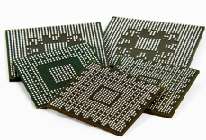








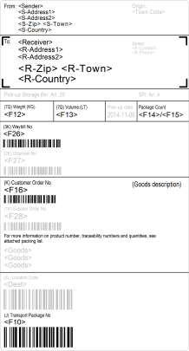
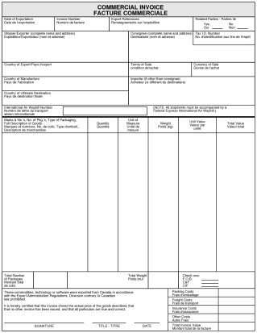
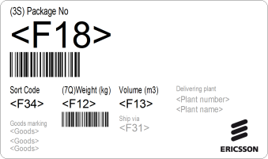

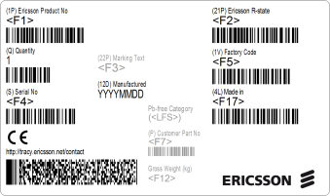

Identity Creations
Reference Data (predefined)
Transaction Data (event driven)
Component
(material)
Product
Packed
Component/Product
Handling Unit
Delivery
Shipment
(lowest
non-assembled part)
(assembled components)
(packaging with one or multiple component/products)
(multiple packed products or other handling units)
(one or many packed products or handling units)
(one or many deliveries)
e.g. KRY 121 104/1
e.g. KRY 112 46/2
e.g. SECE8+37491080
e.g. 8801798044
e.g. 20654395
“Label”: *1
Content: *1
Label: *1
Content: *1
Label: *1
Content: *1 or *n
Label: *1
Content: *n
Label: *1
Content: *1 or *n
Document: *1
Content: *1 or *n
“Direct Part
Marking if
applicable”

Slide 11











Unique Identification
- ISO/IEC 15459
Individual returnable items
Individual products and
product packages
15459-5
Common rules
15459-4
Registration procedure
15459-2
IAC CIN IDENTIFIER
Individual transport units
15459-3
15459-6
15459-1
Groupings

Slide 12










Unique Identification
- ISO/IEC 29161
Individual products and
product packages
Network
Connection
http
Communication
smtp
html
Protocols
xml
ftp
CoAP
syntax
xmpp

